Slide 1

Department of Computer Engineering
Multiplexer
Part II
1

Slide 2
Department Vision & Mission
Department of Computer Engineering
Vision
Achieve academic excellence through education in computing, to create intellectual manpower to explore professional, higher educational and social opportunities.
Mission
To impart learning by educating students with conceptual knowledge and hands on practices using modern tools, FOSS technologies and competency skills there by igniting the young minds for innovative thinking, professional expertise and research.
2

Slide 3
Department of Computer Engineering
Design and implement function using 8: 1 mux
F(A,B,C,D)= Σ m (0,2,3,6,8,9,12,14)

Slide 4
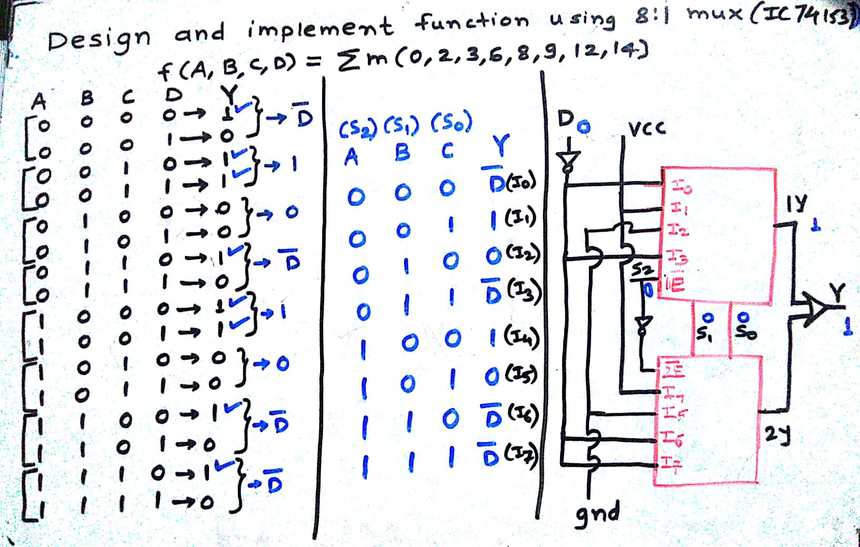
Problems
Department of Computer Engineering

Slide 5
Department of Computer Engineering
Design 16:1 mux using 4:1 muxes only

Slide 6
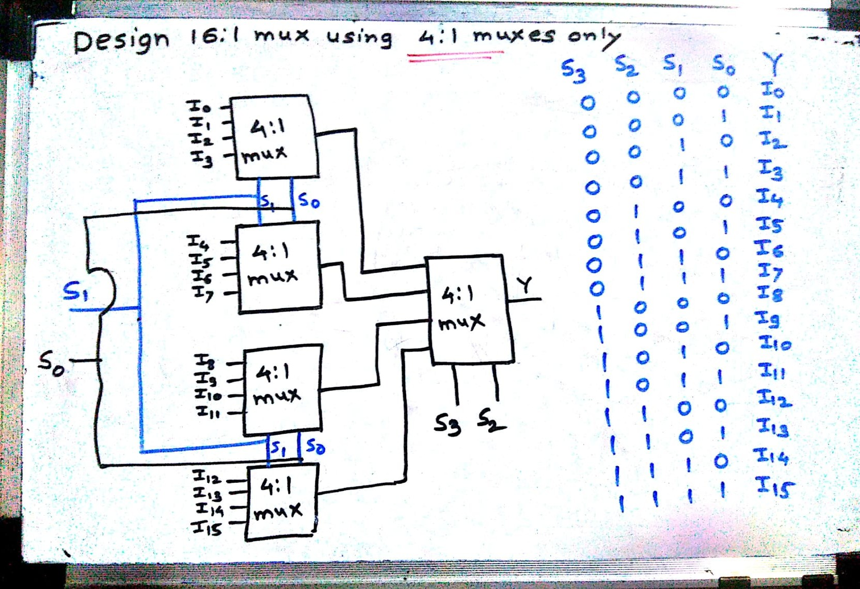
Problems
Department of Computer Engineering

Slide 7
Department of Computer Engineering
Design 16:1 mux using 2:1 muxes only

Slide 8
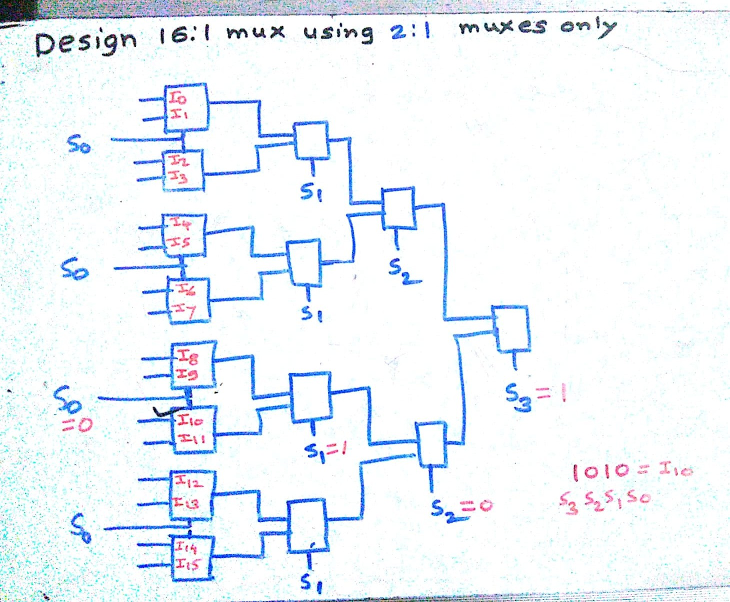
IC 74153 (Dual 4:1 multiplexer)
Department of Computer Engineering

Slide 9
Quiz
Department of Computer Engineering
Please click the following link to open the quiz
https://testmoz.com/q/4219706

Slide 10
Summary
Department of Computer Engineering
Design and implement function using 8:1 mux
Design 16:1 mux using 4:1 multiplexers
Design 16:1 mux using 2:1 multiplxers
Quiz

Slide 11
Department of Computer Engineering
Thank you

